Slide 1
Polio Overview
with an emphasis on
Bulbar Polio
Prepared by:
Richard Daggett
President, Polio Survivors Association
Member, American Academy of Home Care Medicine
Notes:
This afternoon we are going to do a quick review of polio in general, and then talk about bulbar polio. Many of those who had polio, and had any identifiable aftereffects, might also have had bulbar involvement. Also, many polio survivors will scoff and say, “But I was never in an iron lung!” Bulbar involvement affects more than just breathing. Besides, many of you were infants or young children. You may not remember if you any breathing, swallowing, or other of polio’s sneaky damage.

Slide 2
Poliomyelitis, often called polio or infantile paralysis, is an acute, viral, infectious disease spread from person to person, primarily via the fecal-oral route.
The term derives from the Ancient Greek poliós, meaning "grey", myelós “marrow,” referring to the grey matter of the spinal cord, and the suffix -itis which denotes inflammation., i.e., inflammation of the spinal cord’s grey matter.

Slide 3
A severe infection can extend into the brainstem and even into higher brain structures, resulting in polioencephalitis. This can affect breathing, swallowing, and other vital functions.
Notes:
Dr. Perlman has said, “People who had non-paralytic polio, by definition had polioencephalitis. They had involvement of those brain areas above the spinal cord, and could well have had poliovirus changes in the brainstem (bulbar polio). So breathing and swallowing problems may be present even in people who ostensibly had non-paralytic polio and also in others who may have no complaints about their legs or arms.”

Slide 4
Although approximately 90% of polio infections cause no apparent symptoms, affected individuals can exhibit a range of symptoms if the virus enters the blood stream. In about 1-2% of cases, the virus enters the central nervous system, infecting and destroying motor neurons. This leads to muscle weakness and paralysis.
Notes:
I underlined “apparent” because Bodian discovered in autopsies that at least 50% of motor nerves must be damaged before there is any readily apparent weakness.

Slide 5
Different types of paralysis may occur, depending on the nerves involved.
Spinal polio is the most common form.
A person will usually have asymmetric paralysis that most often involves the legs.
Bulbar polio leads to weakness of muscles innervated by cranial nerves.
Bulbospinal polio is a combination of bulbar and spinal paralysis.

Slide 6
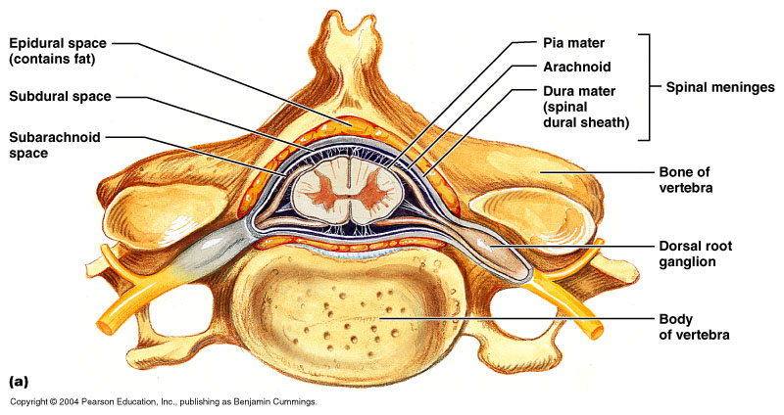
Notes:
This is a cross section of a vertebral column, showing the spinal cord going down the middle and the peripheral nerves exiting on both sides.

Slide 7
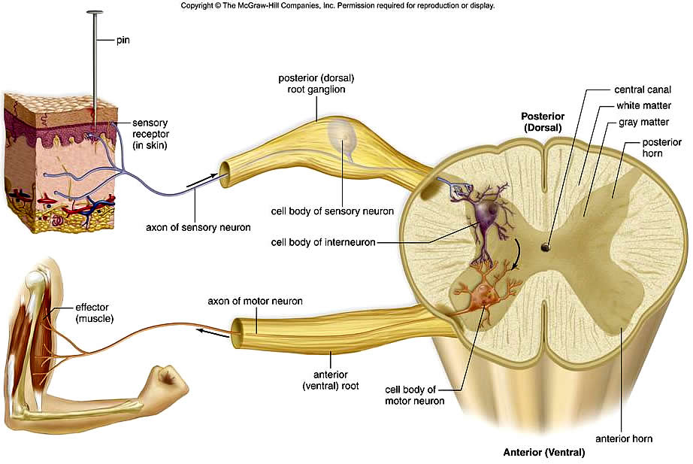
Notes:
Here is another diagram, showing just the spinal cord, and indicating motor nerves and sensory nerves. Sensory nerves are not affected by the polio virus.

Slide 8
The nervous system comprises the brain and various types of nerves, including sensory nerves, which carry impulses from all parts of the body to the brain and motor nerves, which carry impulses away from the brain and to the muscles and all of the organs of the body.

Slide 9
The somatic part of the nervous system has both sensory components which convey sensations from the eyes, the nose, and other sensory organs to the brain where most of the impulses reach our awareness, and motor components which transmit impulses to the skeletal muscles in the limbs and trunk, allowing voluntary control of movements.

Slide 10
The autonomic nervous system (ANS) regulates the functions of our internal organs, such as the heart, stomach and intestines. We are often unaware of the ANS because it functions involuntary or by reflex.
For example, we do not notice when blood vessels change size, or when our heart beats faster, or your intestinal tract is working.

Slide 11
What happens when you contract polio?
The virus enters your mouth.
It travels to your intestines.
The virus multiplies.
If you’re lucky, it is excreted in your feces and you aren’t even aware of it.
Or, you might have flu-like symptoms.
If you are unlucky, the virus enters
your blood and travels to your central nervous system.

Slide 12
Once the virus is in the central nervous system, it can damage nerves in the spinal cord. This damage can occur along the entire length of the spinal cord, from the tail bone to the brain stem.
Autopsy results done in the 1940s by Bodian indicate that at least 50% of motor nerves must be damaged before this damage is apparent.
As noted before, the virus does not damage sensory (afferent) nerves. (note)
Notes:
I put (note) in this slide to remind me to mention two friends of mine who lost movement AND sensation. I wondered about this for years, because we’ve always been told polio doesn’t damage sensory nerves. It turns out that my two friends had damage to their sensory nerves because their polio infection was so severe that their spinal cord became extremely swollen. Their spinal cord was swollen to such an extent that their entire spinal cord was damaged beyond repair, including their sensory nerves. In effect, they had the equivalent of a high spinal cord injury.

Slide 13
In 1875, a polio case was presented to the Society of Biology in Paris. A nineteen-year-old patient had had polio when he was six months old. It paralyzed his left side. The young man had recovered partial use of his left arm and leg and became a tanner, which required him to use his arms to pull heavy, wet hides out of vats of acid. By the time he was seventeen, this French patient reported fatigue and a feeling of heaviness in his right arm, the arm that had apparently not been affected by the polio. His right arm and leg both became weaker and smaller. Known as "the French patient," this appears to be the earliest case of post-polio syndrome studied.
From 1875 to 1900, twenty-four articles appeared in European medical journals describing 30 additional polio survivors experiencing new weakness and sometimes atrophy.

Slide 14
Two things that are important to remember:
Every polio survivor is different.
Every polio survivor is different.
Oops! You think I’ve made a mistake.
No! I wrote this statement twice to emphasize this point. If anyone says to you, or you read an article that says, “All polio survivors …” or “No polio survivors …” it is wrong!

Slide 15
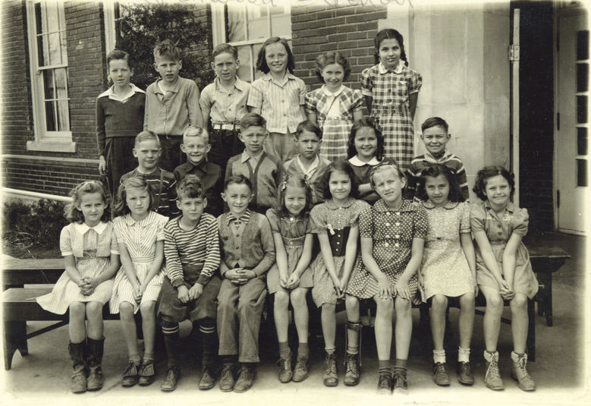
Notes:
Can you identify the polio survivor in this school photograph? In my studies I’ve discovered that all female polio survivors are pretty and all male polio survivors are handsome! And, I’m guessing this girl will find a way to ditch her leg brace when she gets a little older.

Slide 16
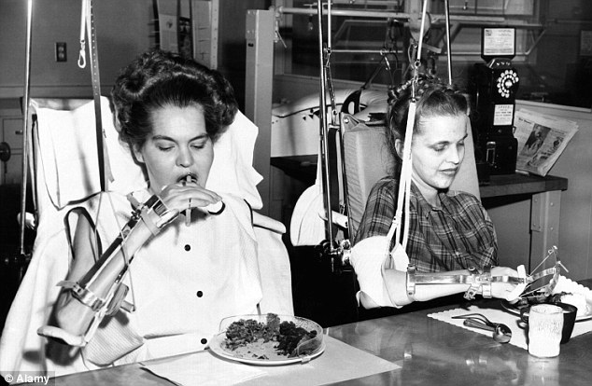
Notes:
It is unlikely that these ladies will be able to hide their disability.

Slide 17
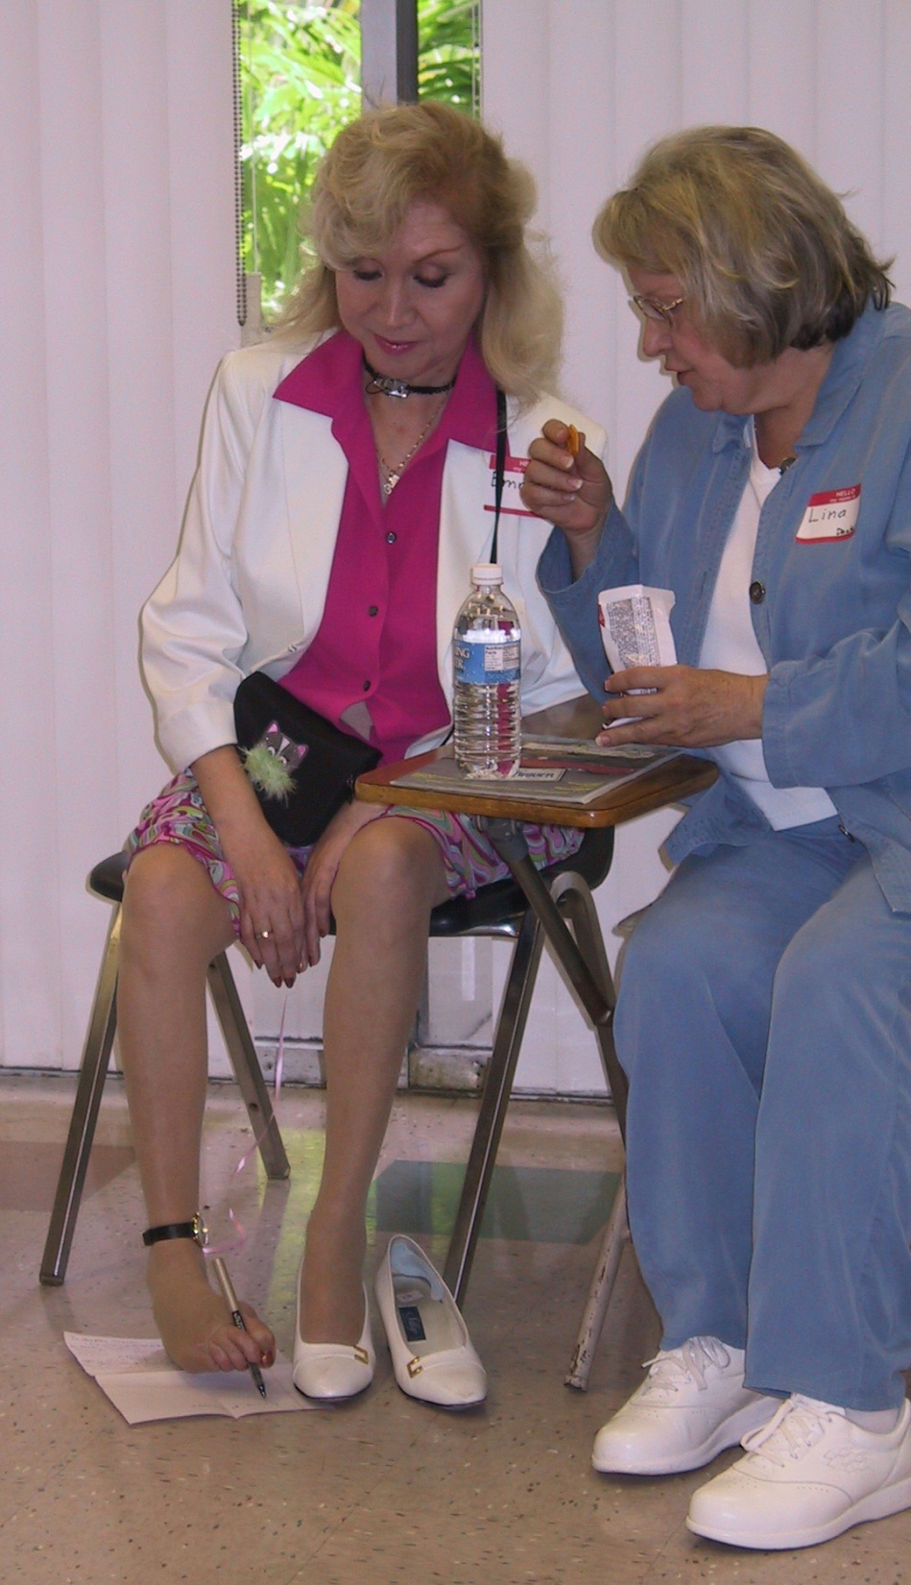
Notes:
Here is our own Emma. She is what we sometimes identify as an “upside down polio.” Her arms and hands were greatly affected, but her legs were strong. She learned to write and type with her feet, and even changed her babies’ diapers with her feet. Notice that she wears a wristwatch on her ankle. Emma also had severe bulbar polio. The “necklace” she is wearing is actually the collar that holds her tracheostomy tube in place.

Slide 18
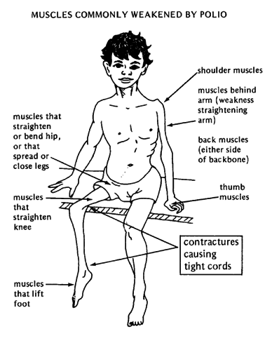
Notes:
Weakness is often asymmetrical. Dr. Perry often said that polio affects the body like someone splattering paint on a wall. There no discernible pattern.

Slide 19
Bulbar Polio
Bulbar polio occurs when the virus invades and destroys nerves within the bulbar region of the brain stem. The bulbar region is a white matter pathway that connects the cerebral cortex to the brain stem. The destruction of these nerves weakens the muscles supplied by the cranial nerves, producing symptoms of encephalitis, and causes difficulty breathing, speaking, and swallowing. Critical nerves affected are the glossopharyngeal nerve, the vagus nerve, and the facial nerve. Other nerves may also be affected.

Slide 20
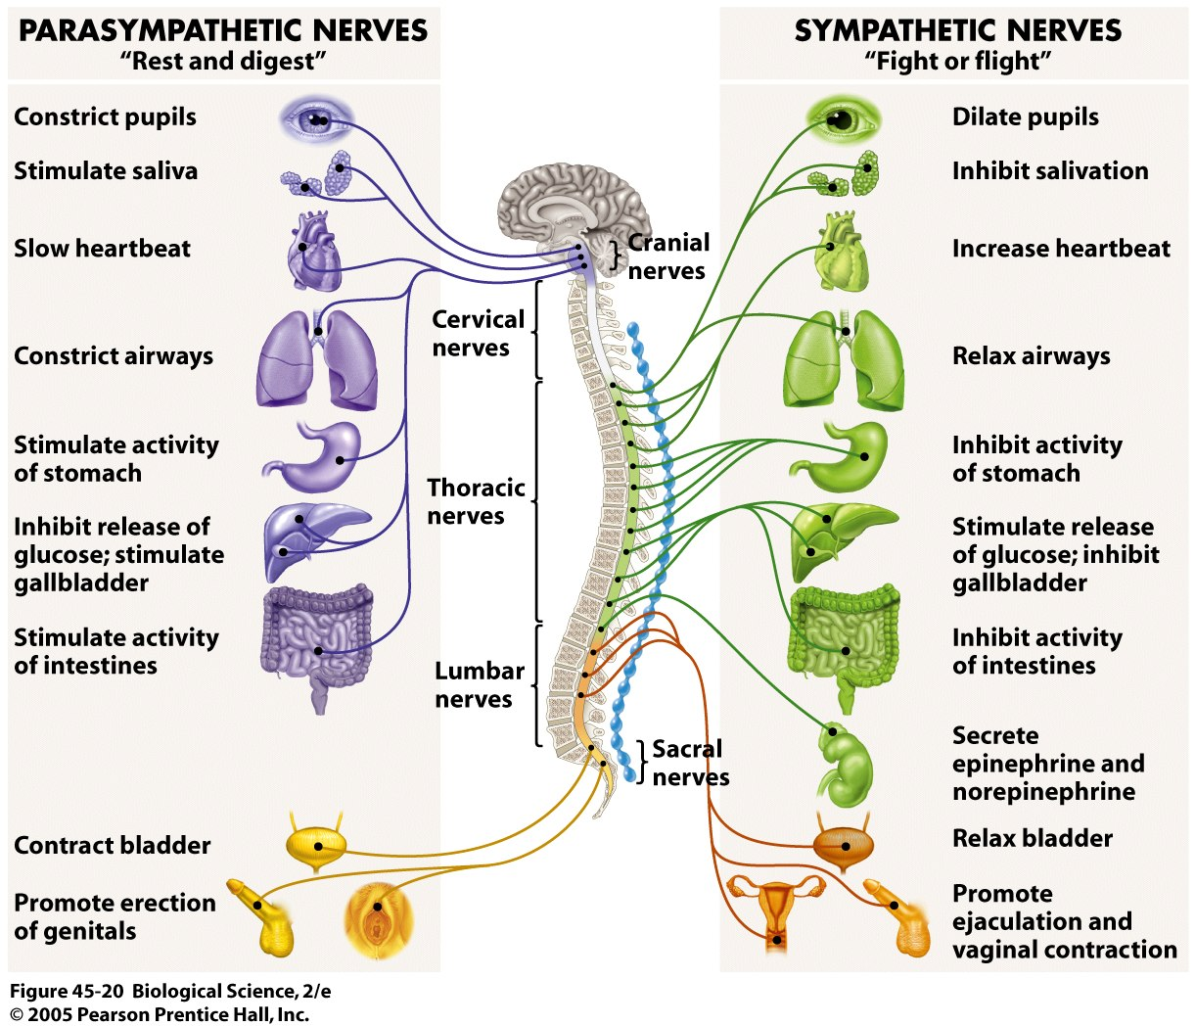
Autonomic Nerves
Notes:
This illustration indicates the many bodily functions that can be affected by bulbar polio.

Slide 21
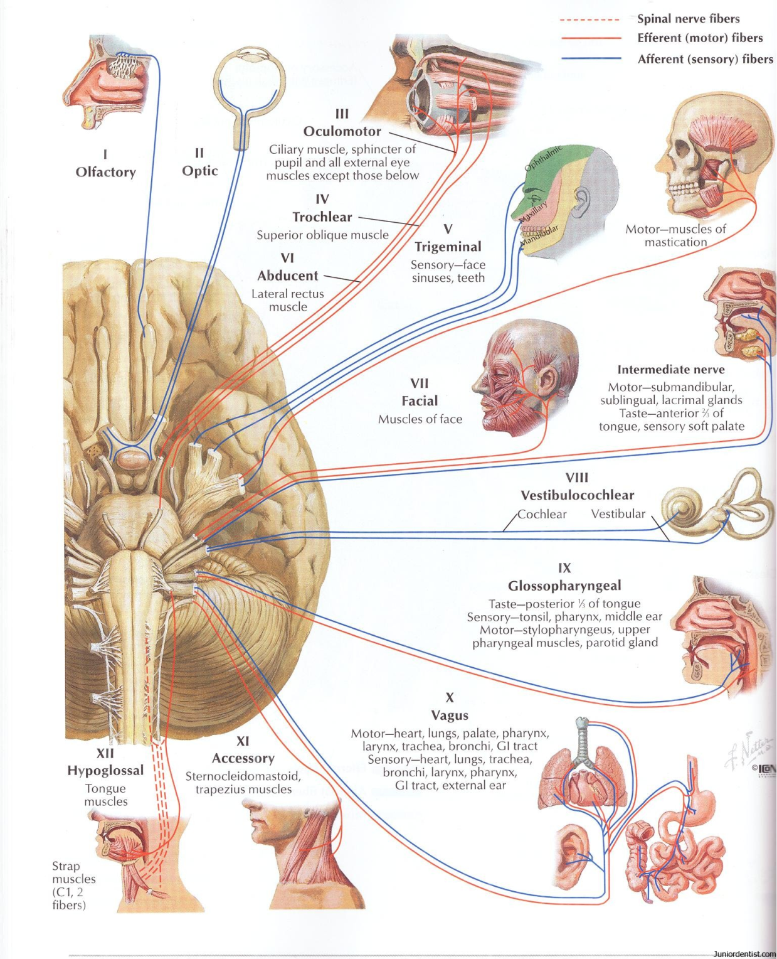
Notes:
Another illustration indicating nerves that originate in the brain, or “bulb” of the spinal cord. Polio most often affects the 7th, 9th, 10th, 11th, and 12th nerves.

Slide 22
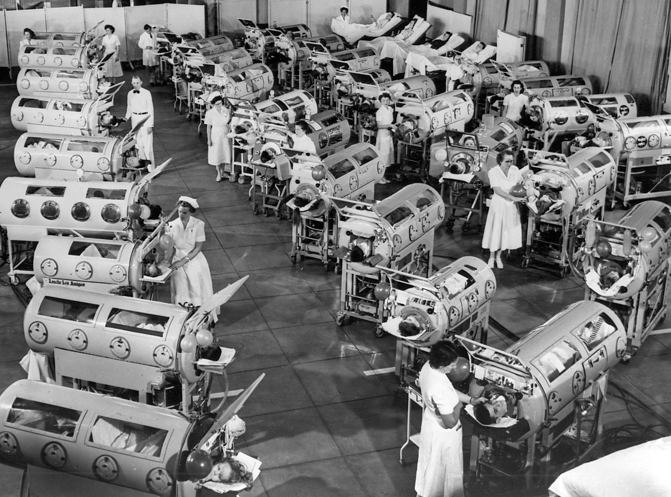
Notes:
Most of you have seen this photograph. It was taken at Rancho Los Amigos in 1953. I was “lucky” enough to be in one of these for six months. This is what most people think about when they think of bulbar polio but, as I indicated, bulbar polio can involve much more than breathing.

Slide 23
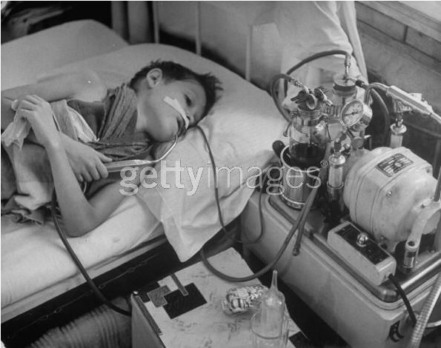
Notes:
Here is a young boy, perhaps nine or ten, who has specific bulbar involvement. His arms and hands are thin, but there doesn’t seem to be major weakness. He is holding a suction cannula in his right hand and a tissue in his left hand. Can you guess why? Because he has lost the ability to swallow! He has a nasogastric tube in his nose, going down into stomach, so he can receive nutrition. He uses the suction machine to remove saliva from his mouth. He cannot swallow at all.

Slide 24
Just as in Spinal Polio,
Bulbar Polio can vary in severity.
One person might have trouble forming words.
Another person cannot swallow.
A third person seems to sleep all the time.
The nerves that originate in the brain stem (bulb) control:
Breathing
Heart rate
Chewing
Swallowing
Sleeping
Arousal or concentration
and many other functions.

Slide 25
Some polio survivors might have few if any visibly apparent symptoms. But, remember, about 50% of neurons must be damaged before there is any visibly apparent weakness.
Also note, many polio survivors were infants. They might not remember if they had bulbar involvement.

Slide 26
OK. We’ve reviewed polio. We know that polio can change our body in many different ways.
We’ve learned that bulbar polio can do things to our body that are not always outwardly evident.
Without being obsessed, what are some of the late effects we should pay attention to.

Slide 27
Breathing:
Do you wake often during the night?
Do you feel tired, even if you think you slept well?
Do you experience:
Frequent yawning?
Talking tires you?
You sleep better with your head elevated?
Morning headaches?
Poor concentration?
Notes:
Morning headaches are a very real warning sign. It often means your oxygen level is low and/or you have a build up of carbon dioxide. Carbon dioxide build up can be a silent killer.

Slide 28
Breathing:
Do you use accessory muscles to take a breath?
Neck muscles?
Elevate your shoulders?
Is your cough weak?
Have you had a pulmonary function test?
A sleep study?

Slide 29
Swallowing:
The nerves that lead to the swallowing muscles originate in the bulbar region.
Research indicates that swallowing problems can occur even if there was no apparent swallowing problem at onset.
Swallowing problems can be aggravated by breathing problems.
Notes:
Remember, you may have had some swallowing involvement when you first had polio, but you were feeling rotten anyway. Swallowing was not your highest priority.

Slide 30
Swallowing:
Swallowing problems can be aggravated by fatigue.
When you are eating you should be eating.
Not talking.
Not laughing.
Not … not … not!
Chewing and swallowing are separate activities, and different (but related) nerves are used.

Slide 31
Internal Organs:
The vagus nerve originates in the bulbar region.
Vagus means “wanderer,” because it wanders throughout your upper body and viscera.
The vagus nerve is part of autonomic nervous system. Acting in concert with other parts of the autonomic nervous system it performs multiple
and essential functions!

Slide 32
Internal Organs:
The autonomic nervous system is divided into three parts:
The sympathetic nervous system
The parasympathetic nervous system
The enteric nervous system
Together, they perform part of the “fight or flight” functions.

Slide 33
Internal Organs:
When something goes wrong in this system it can cause serious problems, including:
Blood pressure problems
Heart problems
Trouble with breathing and swallowing
Sluggish or overactive bowels

Slide 34
Post-Polio Fatigue:
Post-polio fatigue can be divided into three areas:
Muscle fatigue – where your muscles feel very tired and heavy, particularly after physical activity
General fatigue – where you feel an overwhelming sense of physical exhaustion, as if you have not slept for days
Mental fatigue – where you find it increasingly difficult to concentrate, have problems remembering things, and make mistakes that you would not usually make

Slide 35
Post-Polio Fatigue:
For our purposes today we will concentrate on mental fatigue.
The reticular activating system is also located in bulbar region of the spinal cord, at the base of the brain.
The reticular activating system controls the transition from sleep to wakefulness, and the ability to focus attention on something.

Slide 36
Post-Polio Fatigue:
The reticular activating system acts as a gate keeper, dampening down the effect of unwanted stimuli such as loud noises, helping to prevent the senses from being overloaded.
To some extent it also regulates response to the stimuli received from outside and helps to pin point a specific fact through detailed thought.
Coordination of actions related to eating, walking, and urinary functions are also carried out by the reticular activating system.

Slide 37
Post-Polio
Remember. Post-polio is only part of the equation.
Most of us are getting older. Some of us have other medical issues, or the after-effects of injuries and other life altering situations.

Slide 38
Something else to remember:
Just because you had polio, this does not make you immune to other diseases or conditions!
Don’t assume the pain in your side, or the ache in your leg is polio related.
Don’t neglect the headache, the tingling in your arm, or the tightness in your chest.
AND, don’t let any doctor scoff or belittle your symptoms by telling you, “I know it hurts but, after all, you did have polio.”

Slide 39
Thank you for you attention.
If you have questions I’ll try to answer them. But remember, I am not a physician.
I’m just an incredibly curious person, and if I don’t know the answer to something I will search until I find it, or my reticular activating system gives out.

